Slide 1



TELECOM CUSTOMER CHURN ANALYSIS
BUILDING LOYALTY THROUGH EXCEPTIONAL SERVICE
PRESENTED BY: CHUKELU STEPHEN

Slide 2

TABLE OF CONTENT
01
02
03
EXECUTIVE SUMMARY
THE DATA
PROBLEM
04
05
06
OPPORTUNITY
EXPLORATION
PREDICTIVE MODEL
07
08
09
INSIGHTS
RECOMMENDATION
CONCLUSION

Slide 3
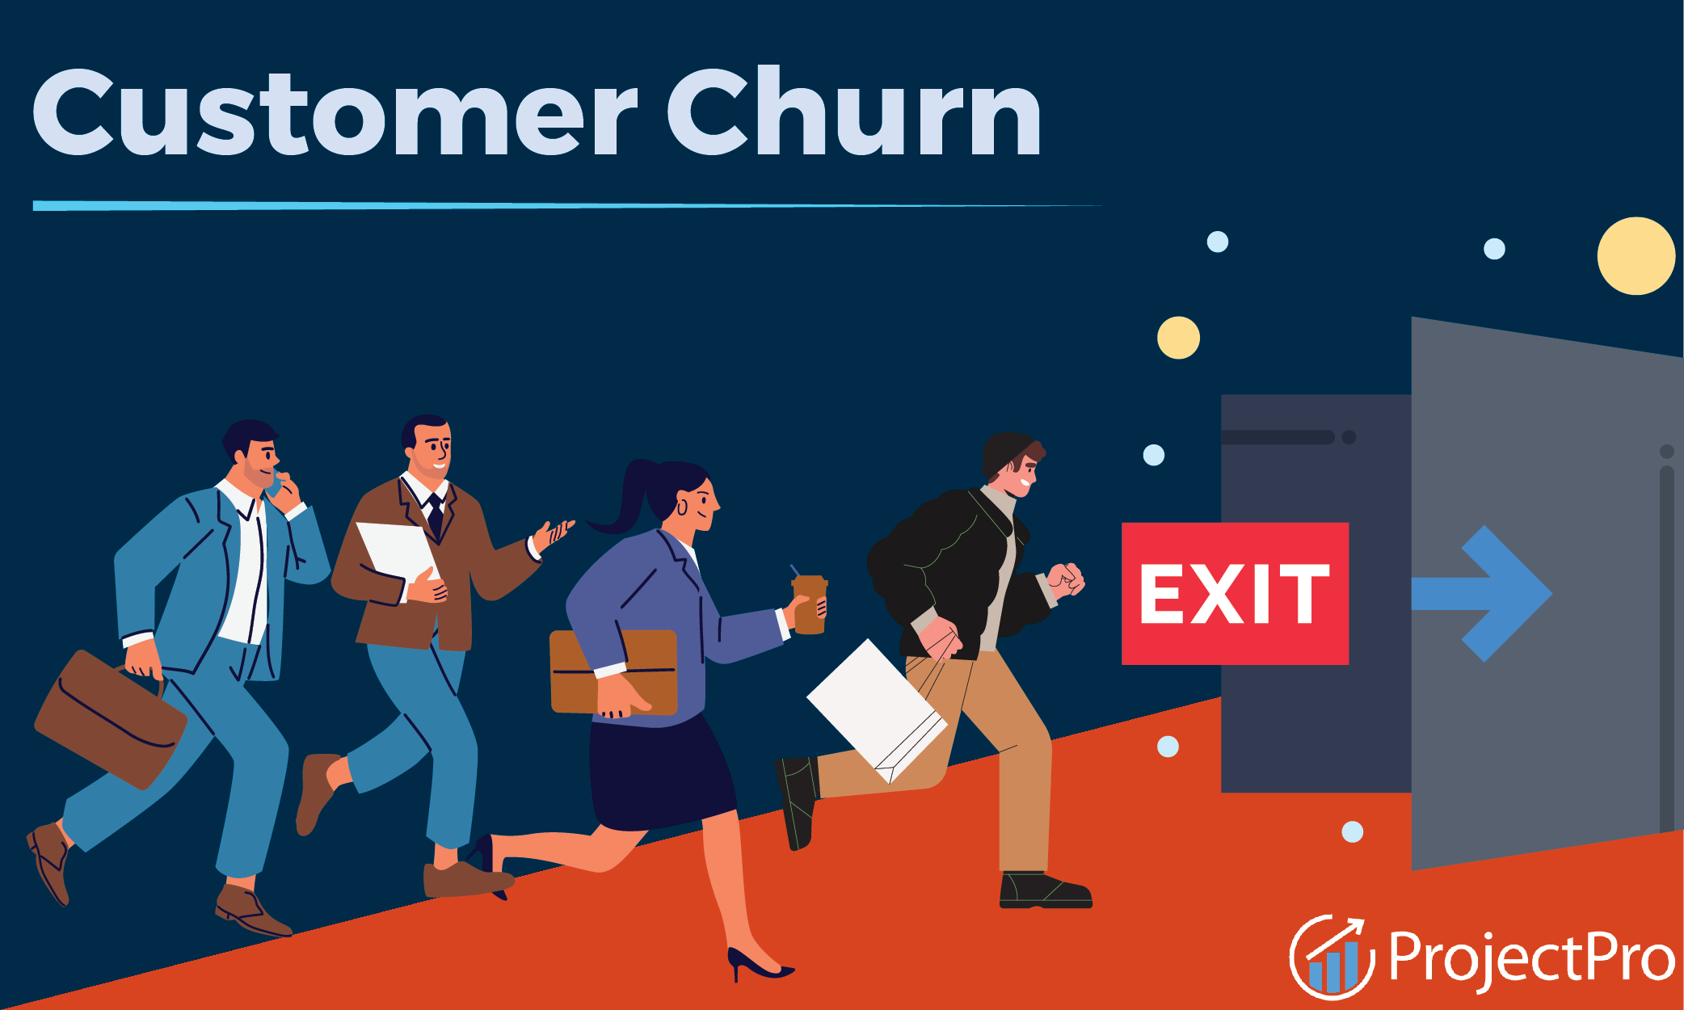

Challenge: Rising churn cuts revenue, raises acquisition costs, and shrinks market share.
Solution: Predictive model to spot at-risk customers early for targeted retention.
Value: Reduce churn by 50%, saving millions and boosting loyalty.
EXECUTIVE SUMMARY

Slide 4
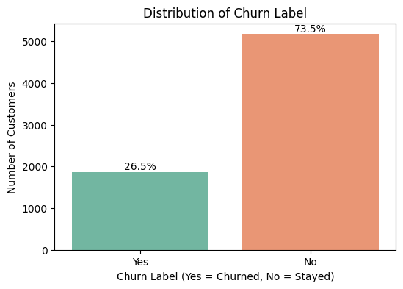
A sample of 7,043 customers was analyzed to predict churn and pinpoint the top drivers that influenced their decision.
THE DATA
Insight: Over 26% of customers churn, with an average monthly charge of $65.
Impact: With Rogers' 12 million subscribers, 26% churn equates to 3.1 million lost customers.
Revenue Loss: This represents a missed revenue of $201.5 million monthly.

Slide 5
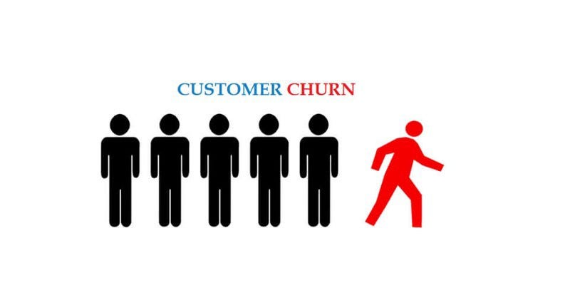
Problem: Despite steady acquisition, churn diminishes value as new and long-term customers leave due to frustration.
Issue: One-size-fits-all strategies waste marketing spend and miss retention chances.
Impact: Acquisition costs 2–3x more than retention, and up to 70% of sales come from repeat customers.
Challenge: Many of our customers exit unnoticed.
PROBLEM

Slide 6
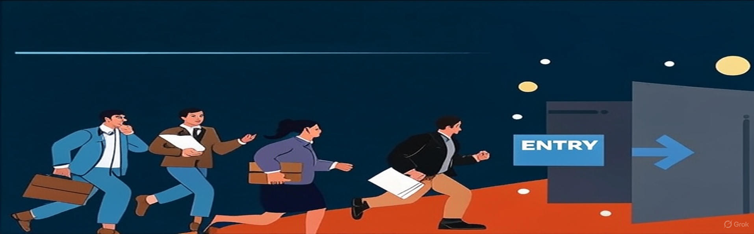
Predictive Churn Model: Leverages advanced analytics to identify at-risk customers, enabling timely interventions.
Actionable Insights: Highlights key churn drivers to shape retention, upselling, and cross-selling strategies.
Revenue Impact: Targets high-value, high-risk customers, boosting ROI and retention rates, & Revenue.
SOLUTION
OPPORTUNITY

Slide 7
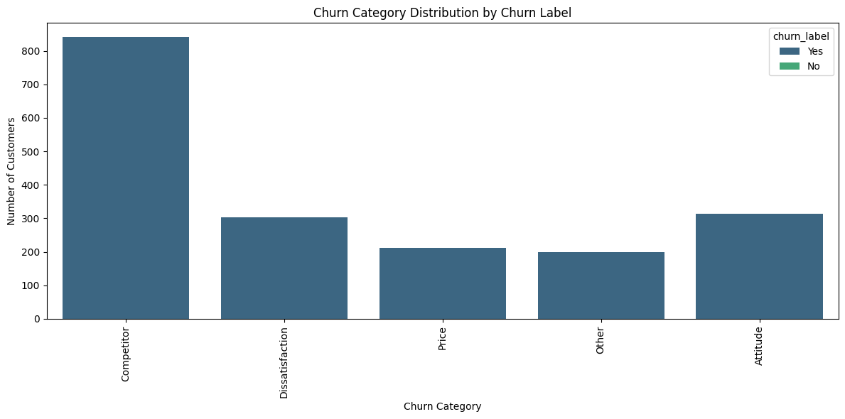
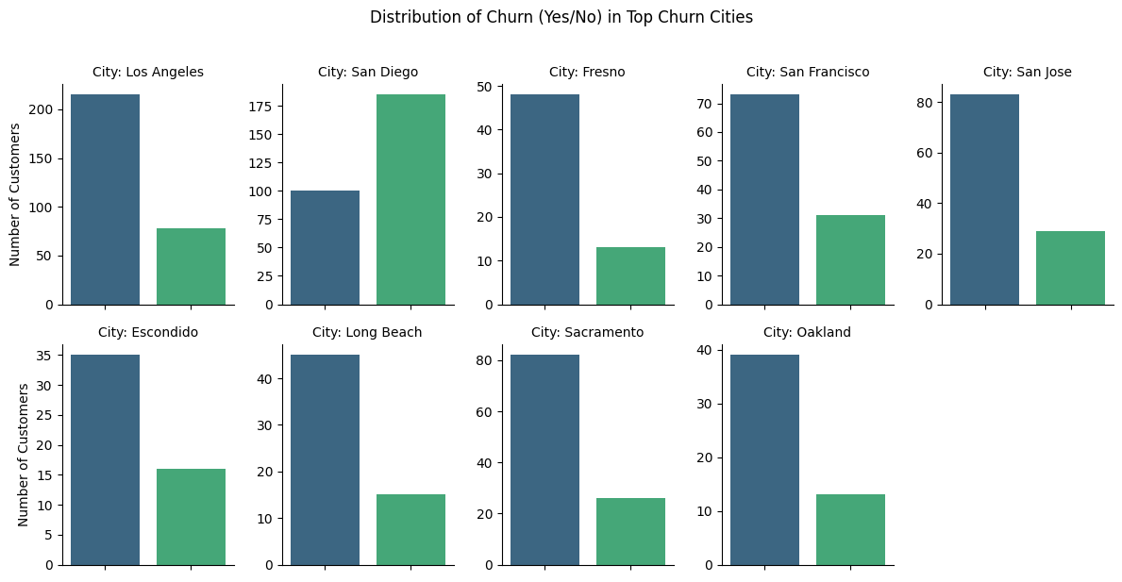
EXPLORATION
Most churned customers left due to competitors.
Dissatisfaction and attitude are the next most common reasons for churn.
Price and other reasons account for a smaller portion of churn cases.
San Diego has the highest churn count among all cities.
Los Angeles also shows a large churn volume.

Slide 8
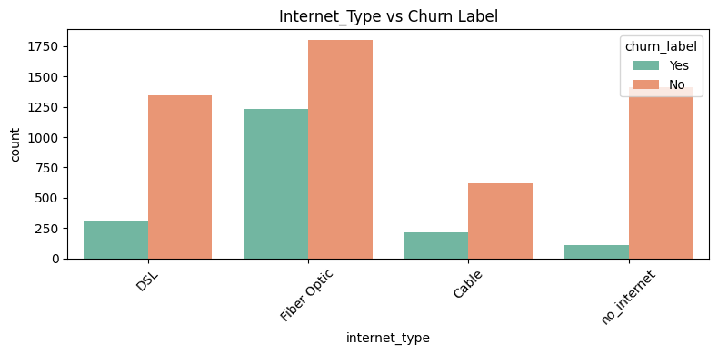
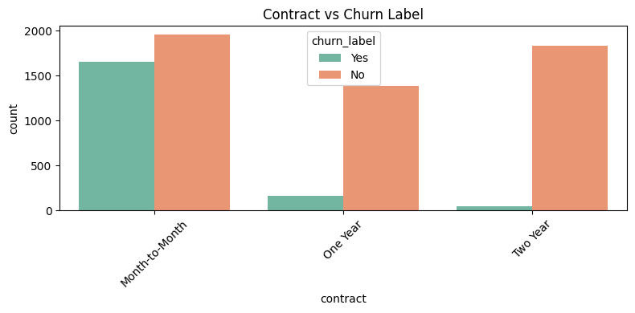
EXPLORATION
Fiber Optic users have the highest churn.
DSL and Cable users show lower churn levels but still contribute to overall losses.
No internet has very low churn numbers, suggesting minimal engagement risk.
Month-to-Month contracts have the highest churn rate, showing significantly more customer losses than other contract types.

Slide 9
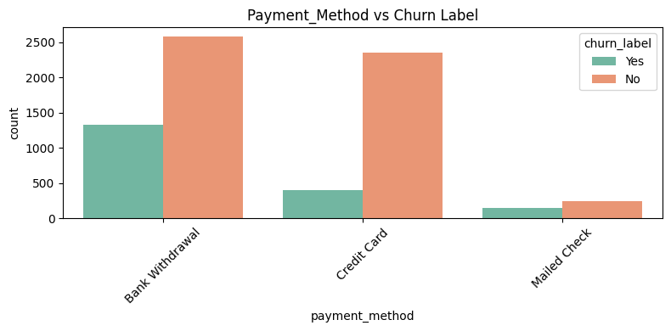
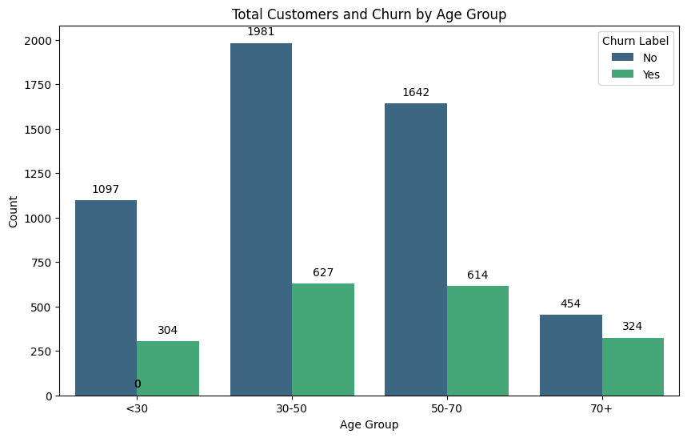
EXPLORATION
Bank Withdrawal customers show the highest churn count among all payment methods.
Credit Card users have a lower churn count but still represent a significant portion of losses.
Mailed Check customers have the lowest churn numbers overall.
“CASH COW” The 30–50 age group and the 50–70 age group have the highest number of churned customers.
Senior citizens have the highest churn rate.

Slide 10
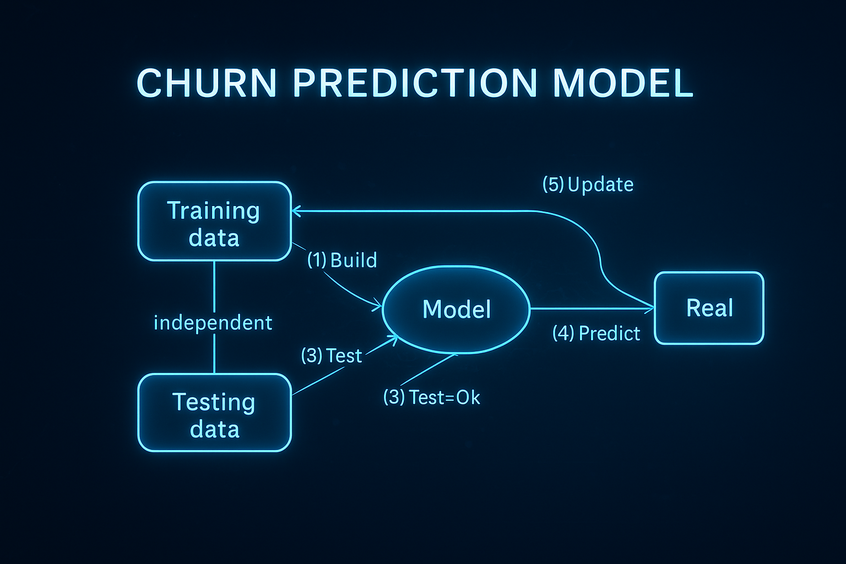
MODEL APPROACH
Build – Train the model using historical data.
Test – Validate the model with new, unseen data.
Predict – Apply it to real customer data for churn prediction.
Update – Continuously retrain with fresh data to adapt to changes.
25 predictive models were tested to identify the most accurate and reliable approach for forecasting customer churn.

Slide 11

BEST MODEL FOR CUSTOMER CHURN
Efficiently flags 9 out of 10 customers likely to churn
Avoids alerting customers who are unlikely to churn
Ensures retention campaigns are cost-effective by minimizing wasted offers on customers who would have stayed.
Recall is a measure from classification analysis that tells you how well a model identifies all relevant cases in a dataset.
Recall measures how many of the actual churners our model correctly identified.
XG Boost Tuned Performance | Validation
Recall | 0.9108
ROC-AUC | 0.9923
F1 Score | 0.9282
Accuracy | 0.9626
Precision | 0.9462

Slide 12
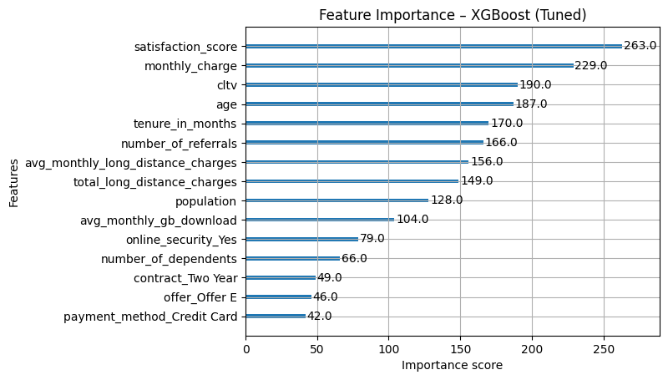
TOP PREDICTORS
Notes:
A 45-year-old high CLTV customer who has been loyal for years might churn if competitors offer better value, because their loss would be costly to the company.
A 28-year-old low CLTV customer might churn quickly for a cheaper plan, representing a smaller but more frequent churn segment.
Low CLTV → may indicate lower engagement, short contracts, or low service usage — higher churn risk.
High CLTV → in some cases, these customers may churn if they feel neglected or find a better deal elsewhere because they know their worth.

Slide 13


INSIGHTS
Satisfaction score: Unhappy customers are far more likely to leave.
Monthly charge: Higher bills will push customers away.
CLTV: Customers with certain value profiles (high or low) have different churn behaviours.
Age: Younger customers may be more price-sensitive and prone to switching, while older customers may be more loyal but still leave if service expectations aren’t met
Tenure in months: shorter-tenure customers are more likely to churn.
Low referrals may reflect weaker brand connection and a higher churn risk.

Slide 14

RECOMMENDATION
CUSTOMER FEEDBACK LOOP
COMPETITIVE PRICING
INCENTIVIZE REFERRALS
UNLIMITED LONG-DISTANCE PACKAGES
PERSONALIZE OFFERS BASED ON VALUE
MAKE PAYMENT OPTIONS EASIER
Notes:
A true customer-centric strategy requires a cultural shift within the organization. Every employee should understand the importance of the customer and strive to deliver exceptional service. A true customer-centric strategy necessitates a cultural shift within the organization. Every employee must comprehend the importance of the customer and strive to provide exceptional service.

Slide 15
RECOMMENDATION
PERSONALIZED EXPERIENCES MAKE CUSTOMERS FEEL VALUED AND UNDERSTOOD.
BY TAILORING INTERACTIONS, PLANS, AND OFFERS TO INDIVIDUAL NEEDS, OUR BUSINESS CAN CREATE STRONGER EMOTIONAL CONNECTIONS.
IMPROVE SERVICE QUALITY
LOYALTY PROGRAMS
PROMOTE LONG-TERM CONTRACTS
EMPLOYEE TRAINING
BUNDLED DISCOUNTS
LEADERSHIP COMMITMENT
Notes:
A true customer-centric strategy requires a cultural shift within the organization. Every employee should understand the importance of the customer and strive to deliver exceptional service. A true customer-centric strategy necessitates a cultural shift within the organization. Every employee must comprehend the importance of the customer and strive to provide exceptional service.

Slide 16
CONCLUSION
ADDRESSING COMPLAINTS PROMPTLY AND CONSTRUCTIVELY TURNS DISSATISFACTION INTO OPPORTUNITY, SHOWING CUSTOMERS THEIR FEEDBACK MATTERS.
EVERY RESOLVED ISSUE IS A STEP TOWARD IMPROVED SERVICE QUALITY AND DEEPER CUSTOMER RELATIONSHIPS.
ULTIMATELY STRENGTHENING RETENTION AND LIFETIME VALUE.
EVEN THE BEST BUSINESSES FACE COMPLAINTS

Slide 17
THANK YOU
I hope you gained valuable insights into how a customer-centric approach can drive loyalty and success for your business.

